Slide 1
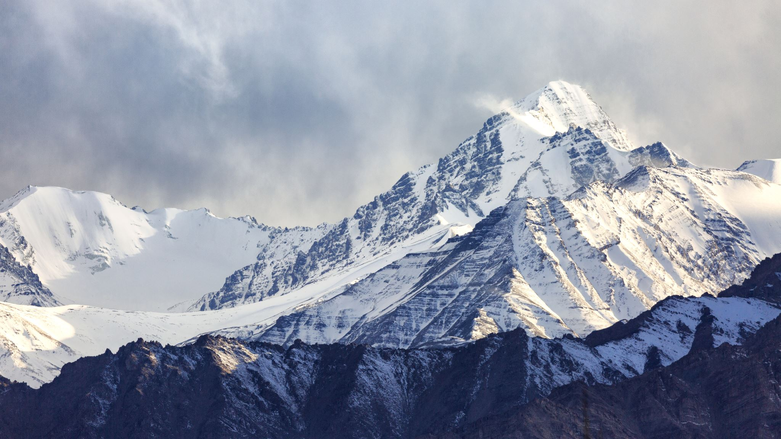
Mangalore Tibetan Student Union (MTSU)

Slide 2
Mangalore Tibetan Student Union (MTSU) Established in September 2018 Vision: Helping Tibetan/Himalayan students find best affordable places with updated curricula and facilities.

Slide 3
Objectives:
Reserve seats for Tibetan and Himalayan students.
Help students find well-registered or approved colleges from UGC with affordable fees.
Find scholarships and concessions for students.
Provide financial assistance to economically disadvantaged students through scholarships or discounts from affiliated colleges.
Organize career counselling sessions to inform 10th and 12th-grade graduates about different careers and available career opportunities in Mangalore.
Promote Tibetan culture and heritage in Mangalore.
Find affordable pathways for pursuing higher degrees after diploma, undergraduate, and postgraduate studies.

Slide 4
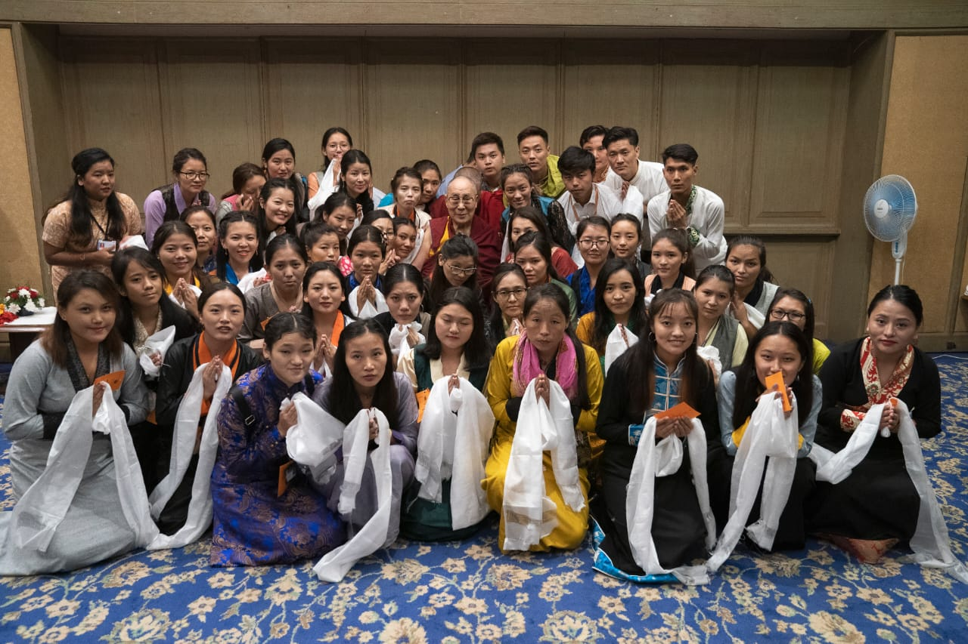
MTSU Students blessed by His Holiness in Mangalore(2019)

Slide 5
Universities/ colleges paneled with MTSU

Slide 6
Total students admitted till the date
S. No | Academic year | Number of Students Admitted
1 | 2018 | 14
2 | 2019 | 61
3 | 2020 | 48
4 | 2021 | 49
5 | 2022 | 75
6 | 2023 | 53
Total |  | 300

Slide 7
Total Number of Graduated students
S. No. | Name of Course | No. of Students
1 | GNM Nursing | 48
2 | BSc Nursing | 18
3 | PB. BSc Nursing | 16
4 | MSc Nursing | 1
5 | Bachelor in Audiology Speech-Language Pathology | 2
6 | Bachelor in Physiotherapy | 8
7 | BSc. Food Nutrition and Dietetics | 4
8 | BSc. Hospitality Management | 8
9 | Bachelor in Engineering | 4
10 | Bachelor in Computer Application | 2
11 | MBA | 1
12 | MSc MLT | 1
Total |  | 113

Slide 8
Students Studying in differents Courses 2023
S. No. | Name of Course | No. of Students
1 | GNM | 89
2 | Bsc Nursing | 59
3 | PB Bsc Nursing | 16
4 | Msc Nursing | 2
5 | Msc. MLT | 1
6 | Bsc Microbiology | 1
7 | Bsc Physician Assistant | 4
8 | Bsc Food Nutrition and Dietetics | 1
9 | Bachelor in Physiotherapy | 6
10 | Bachelor in Engineering | 5
11 | Bsc Hospitality science or Hotel management | 1
12 | Bachelor in Computer application | 2
Total |  | 187

Slide 9
Scholarships or concession availed
S. No | Academic year | Scholarship (Rs)
1 | 2018 | 1,10,000
2 | 2019 | 2,21,000
3 | 2020 | 4,35,900
4 | 2021 | 3,46,500
5 | 2022 | 6,76,480
6 | 2023 | 4,52,500
Total |  | 22,42,380

Slide 10
Achievements of MTSU

Slide 11
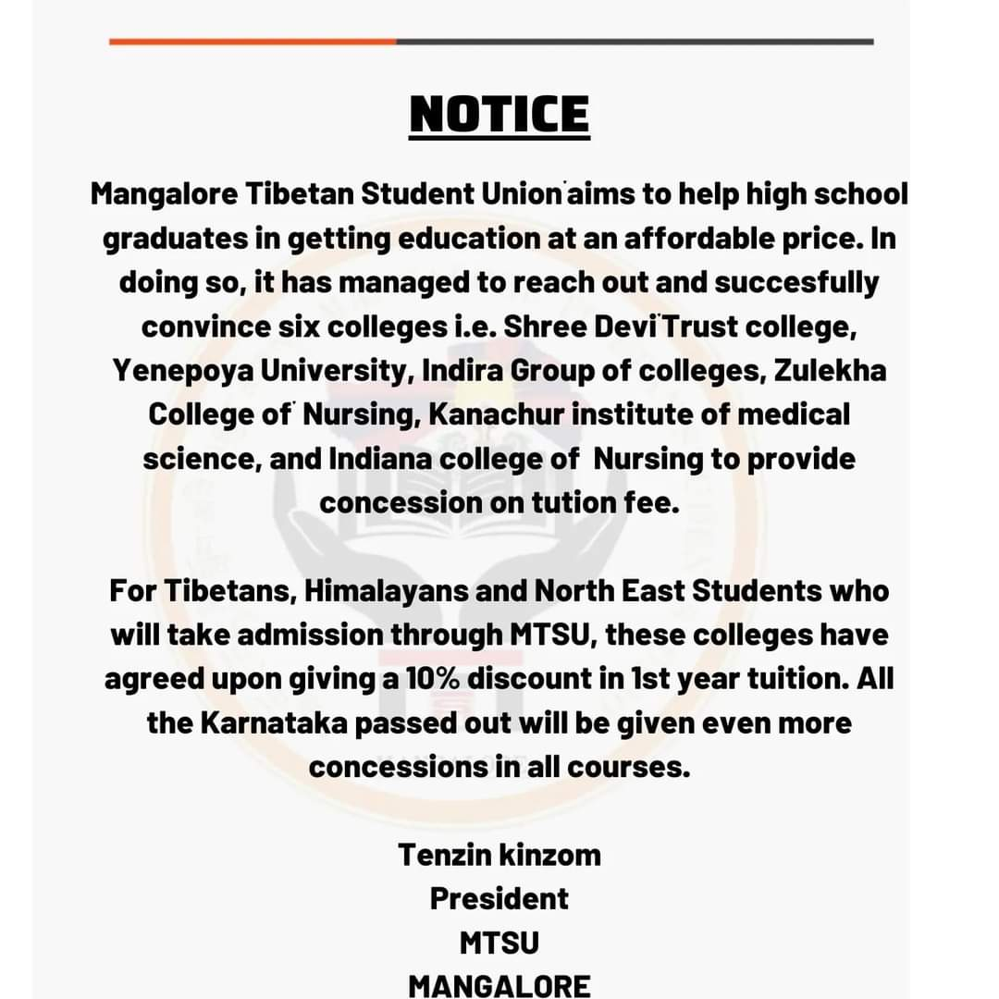
10% scholarship or concession received on reserved seat

Slide 12
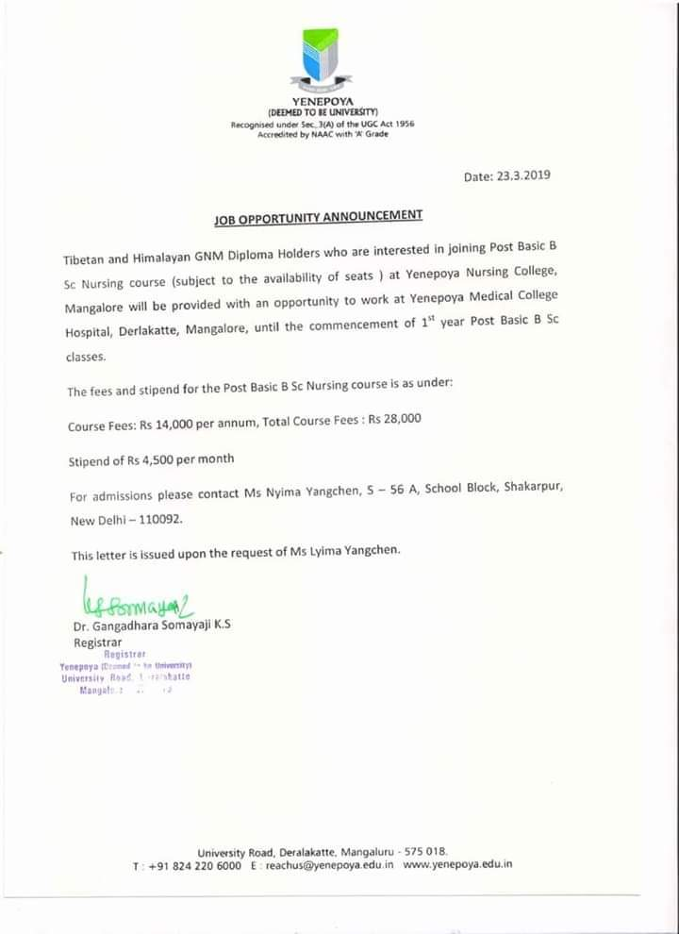
Job placements

Slide 13
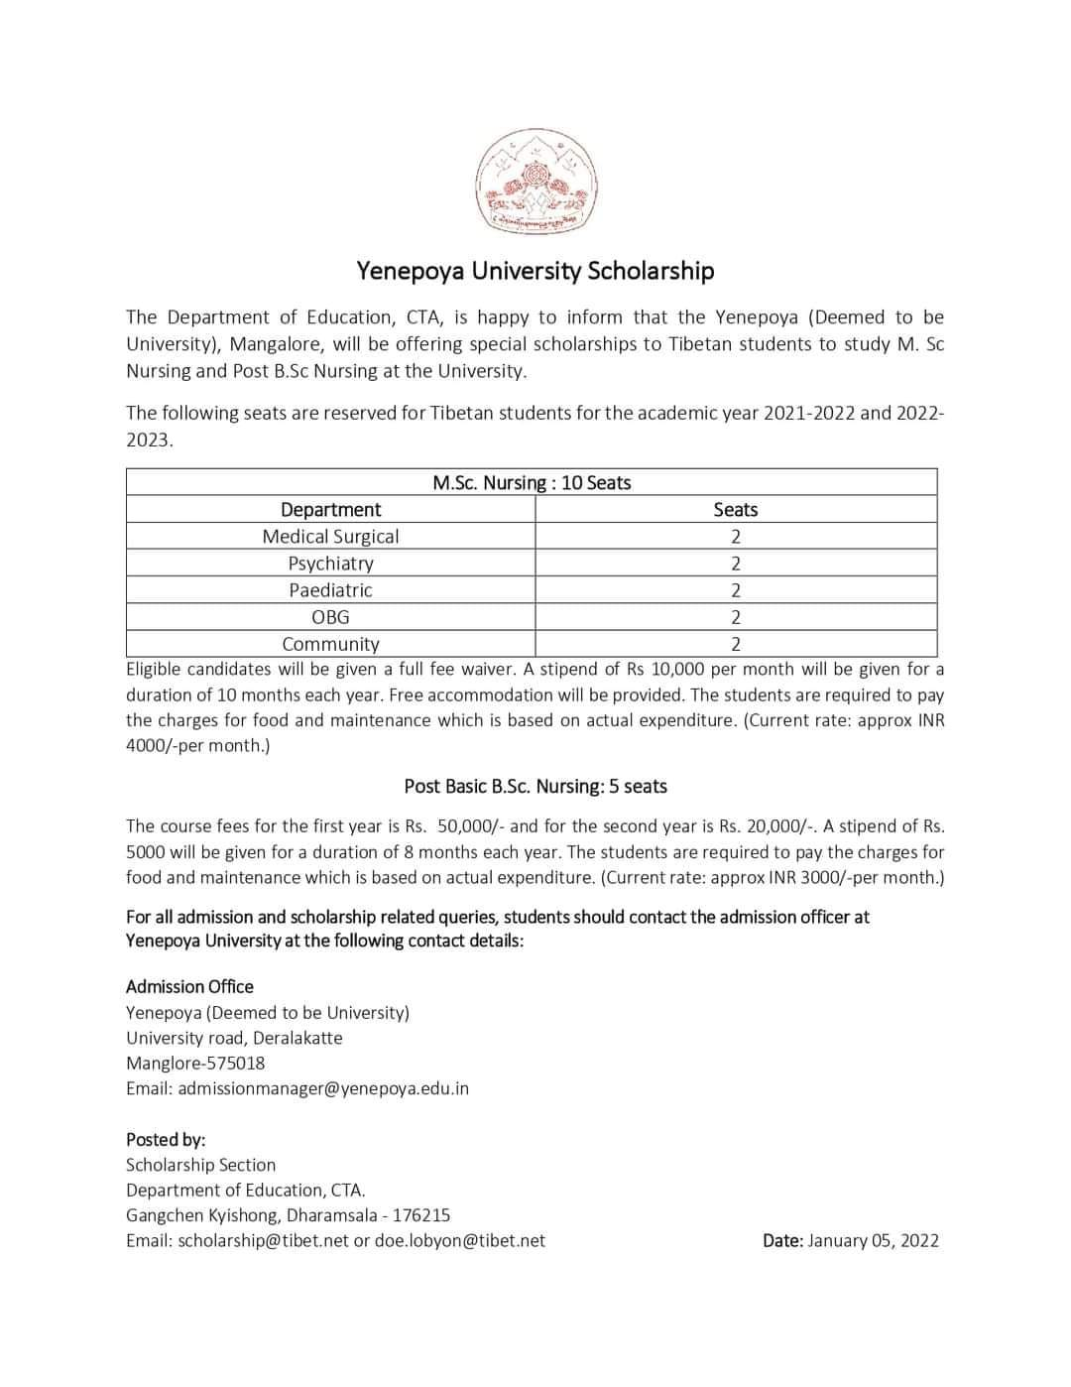
Free MSc seats and Post BSc seats with low fees and Stipend

Slide 14
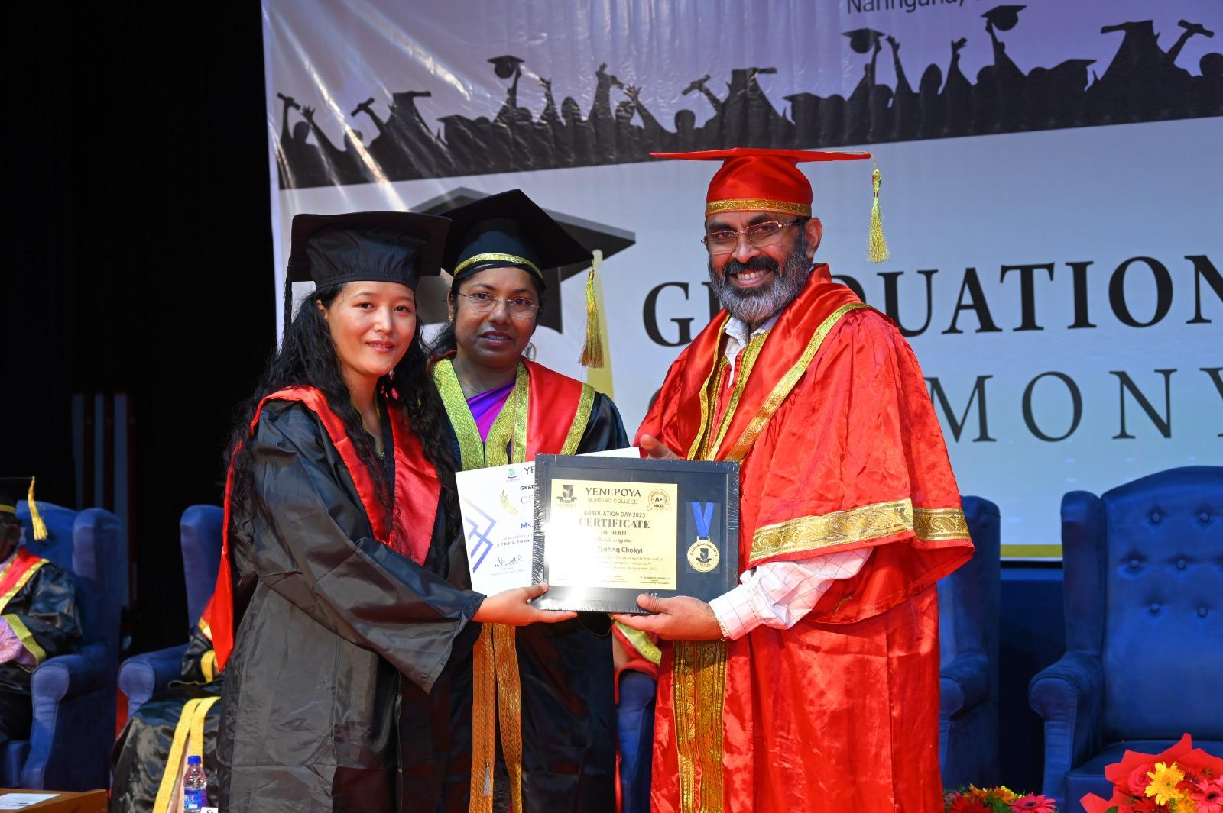
Gold Medalist from yenepoya deemed to be University

Slide 15
Programs Initiated

Slide 16
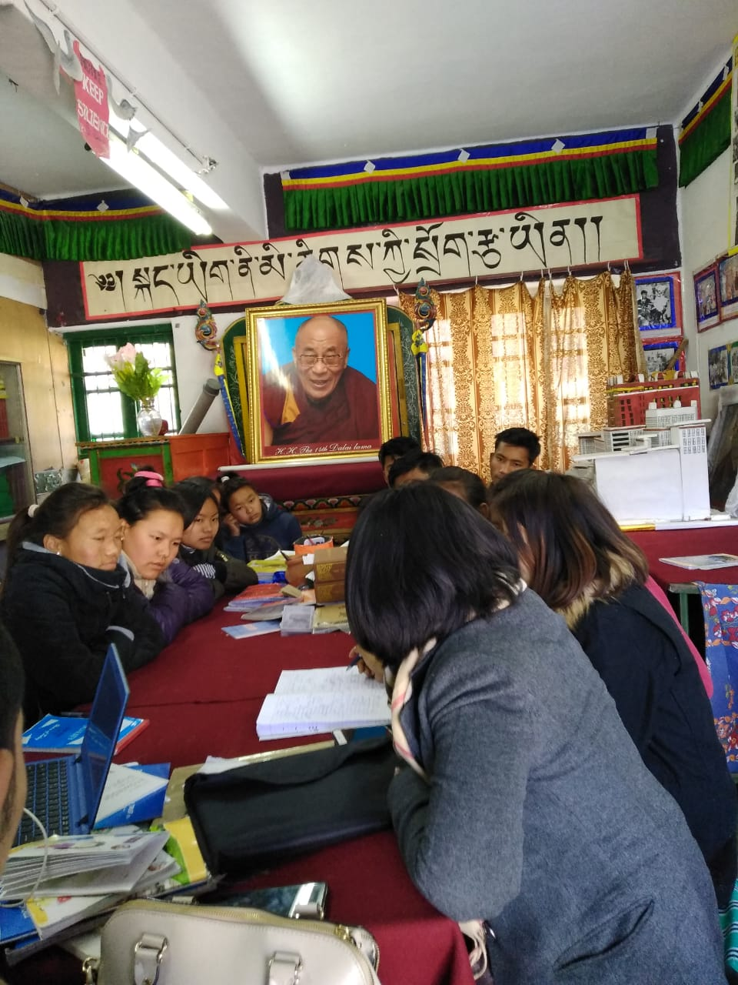
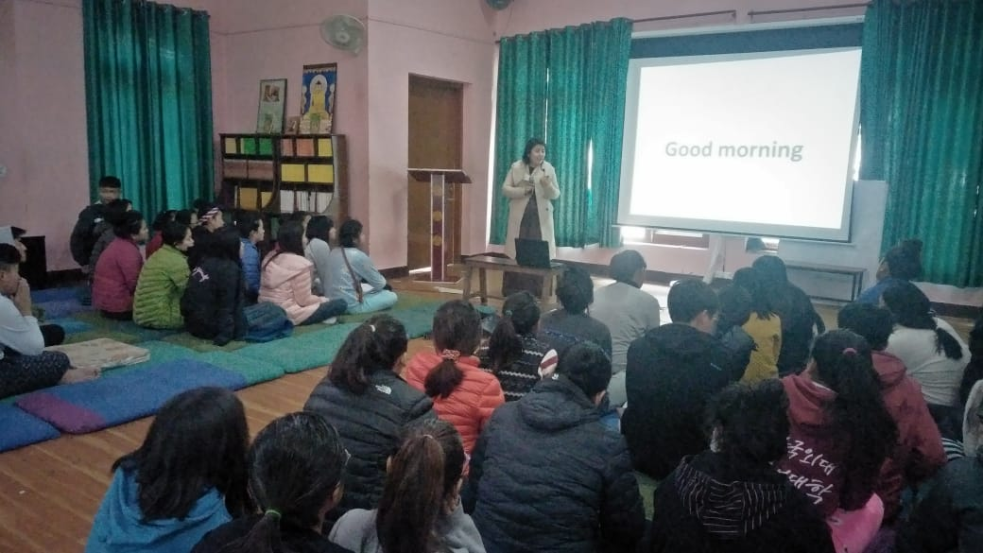
Career counseling sessions in tibetan schools and sikkim Govt schools.

Slide 17
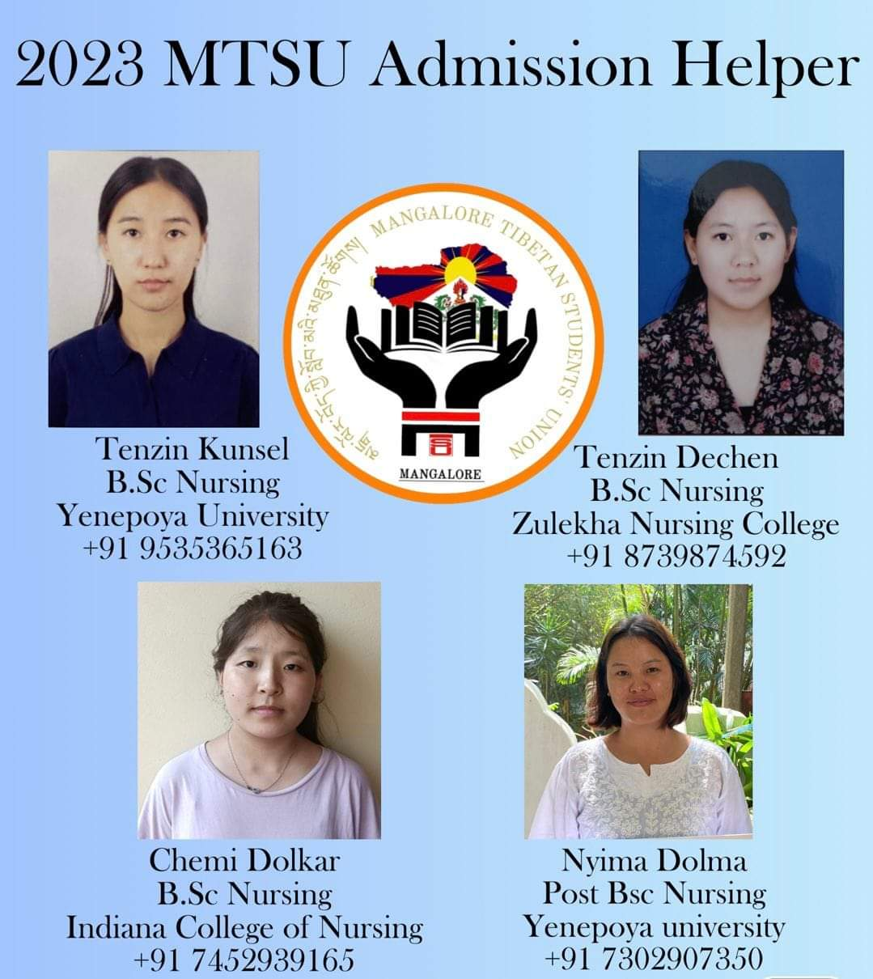
Appoints admission helpers every year.

Slide 18
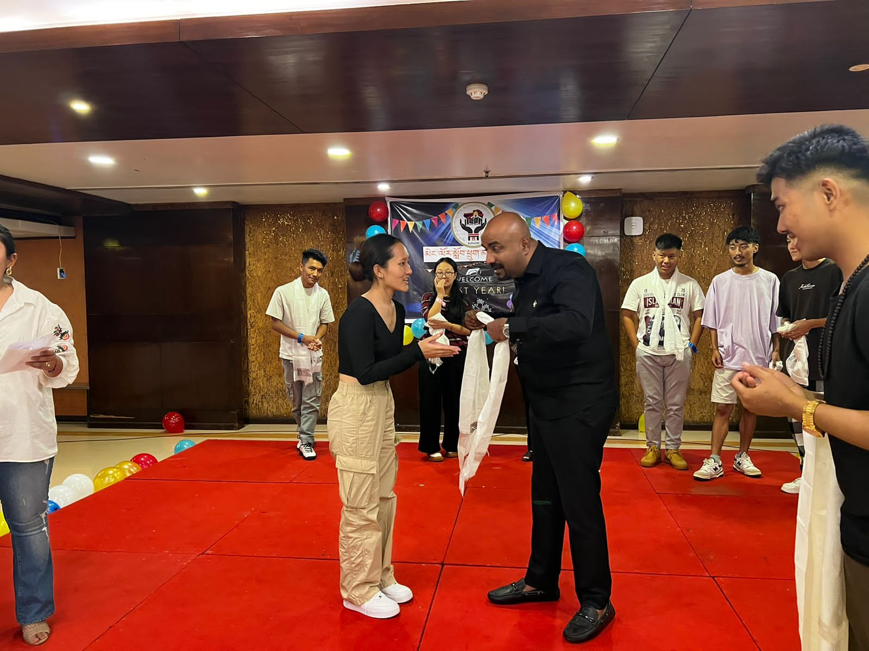
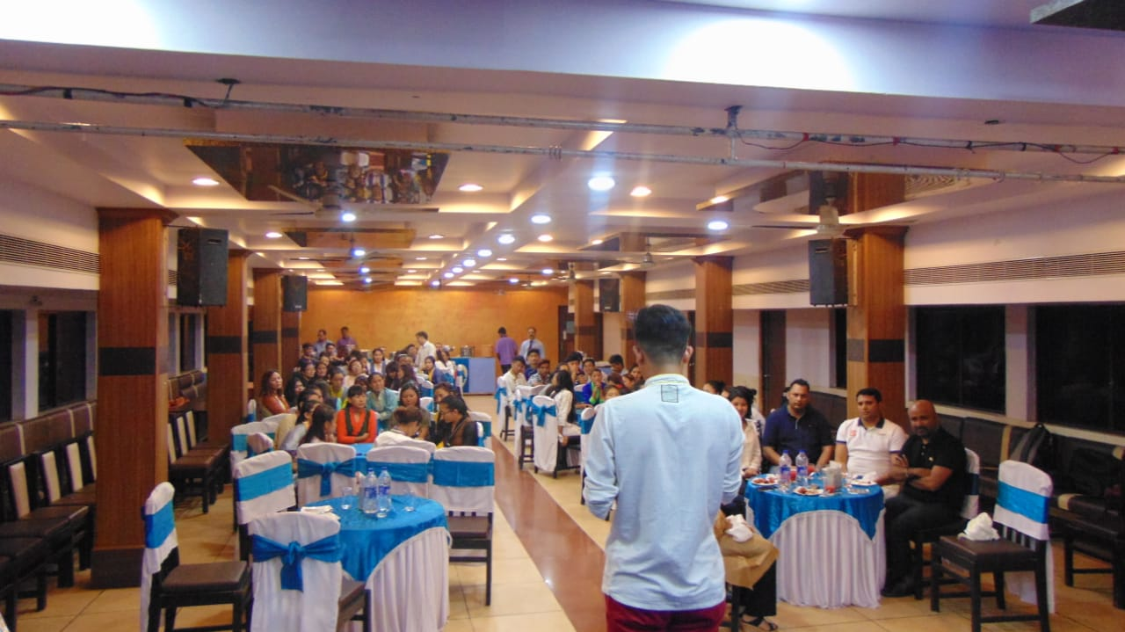
Welcome program for freshers every year.

Slide 19
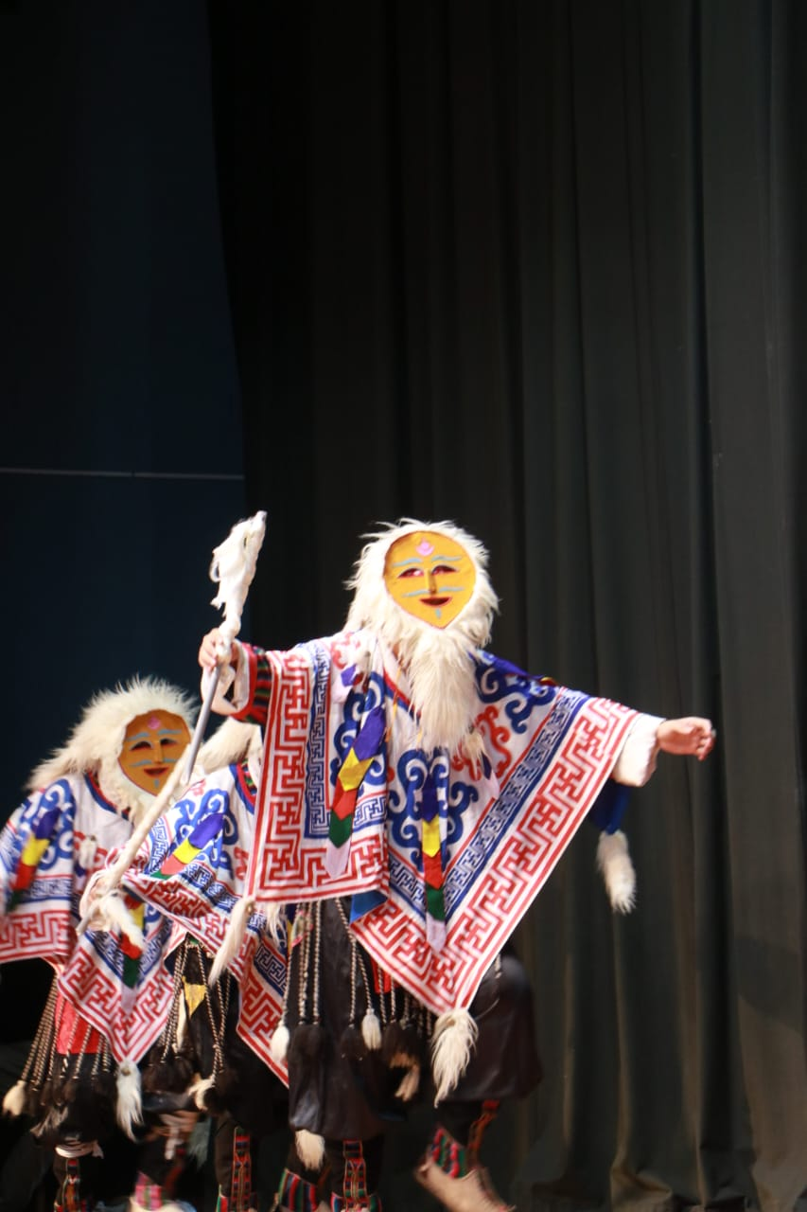
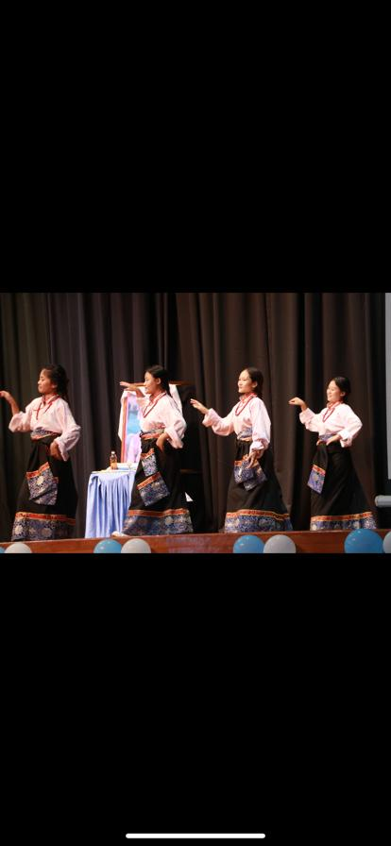
His Holiness Birthday celebration every year by Organizing cultural programs.

Slide 20
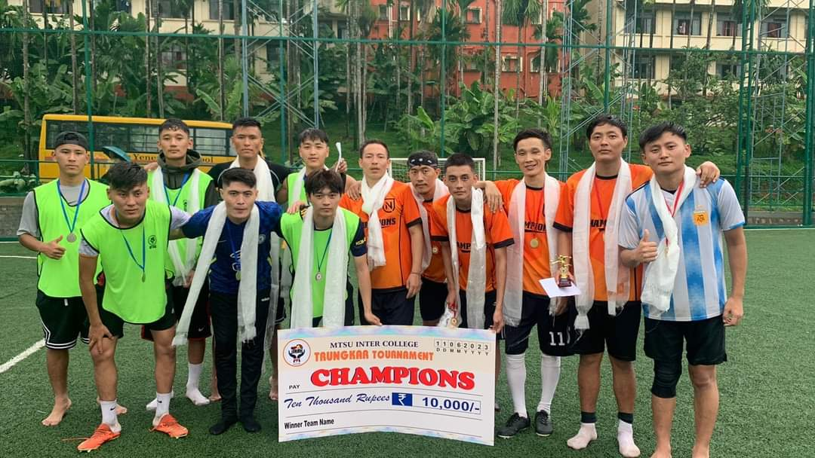
Sports Events.

Slide 21
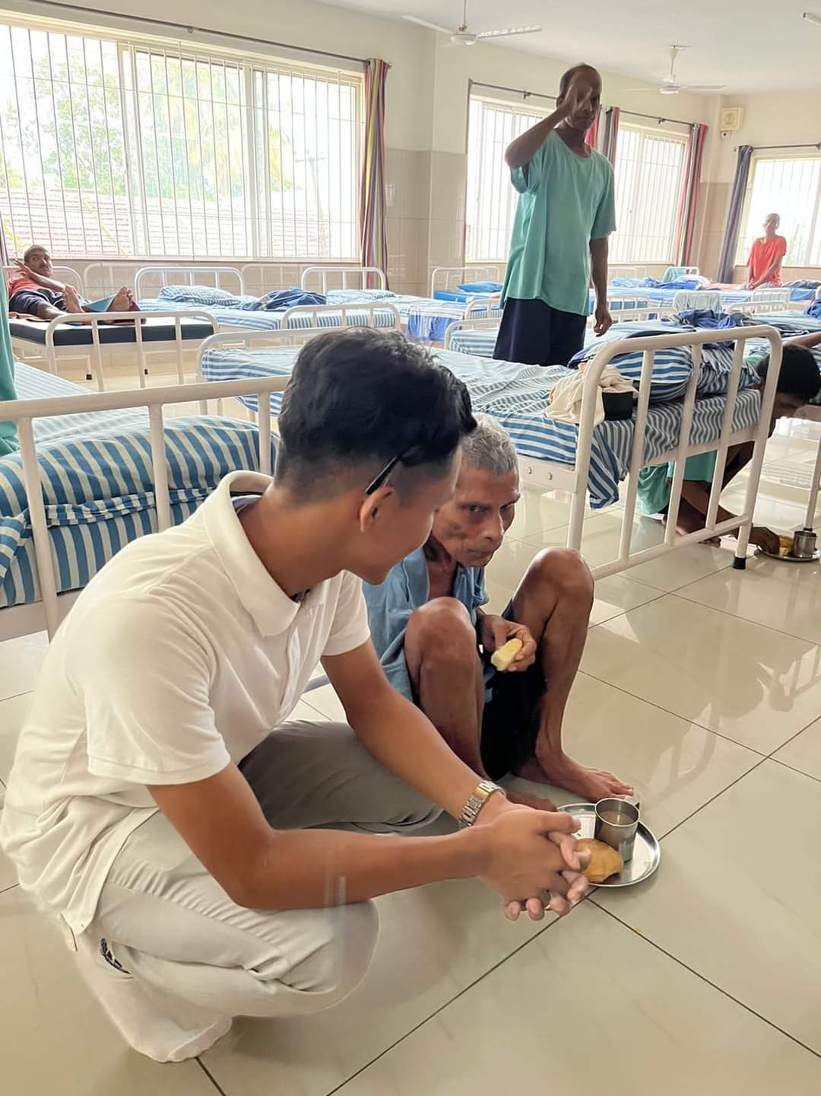
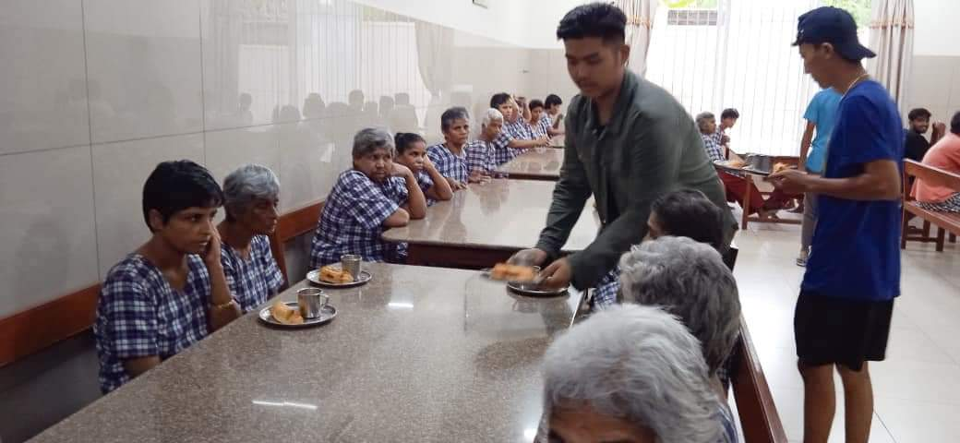
Distributing Snacks at Destitute homes.

Slide 22
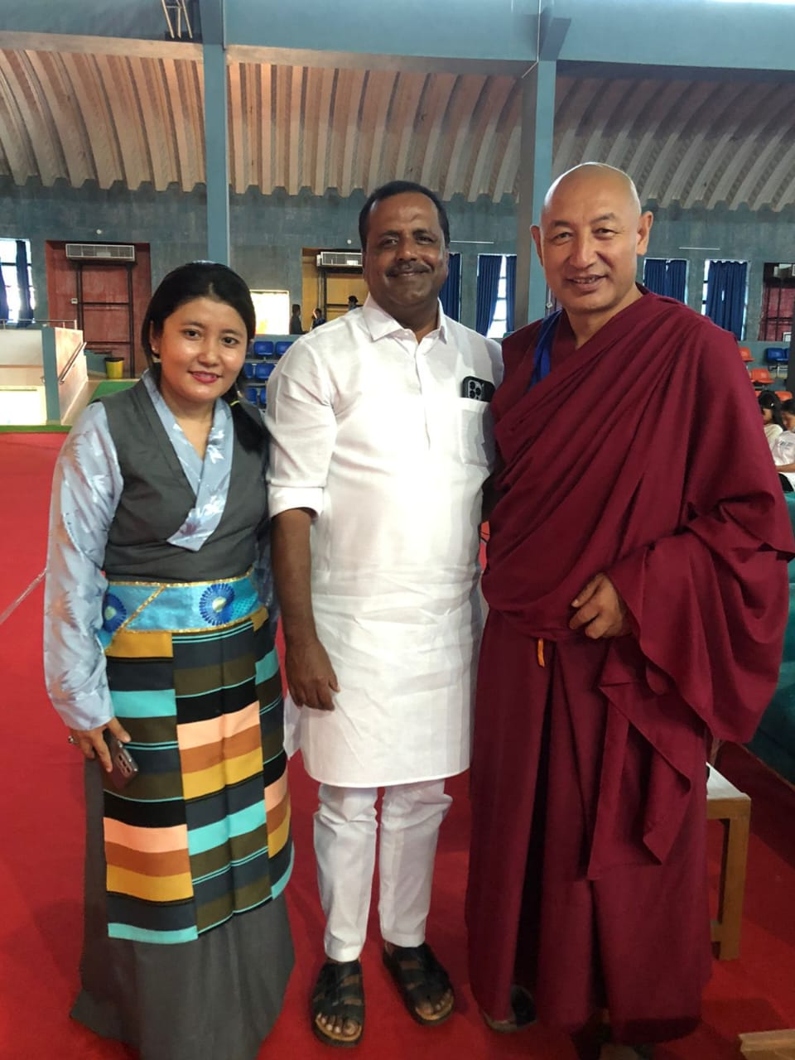
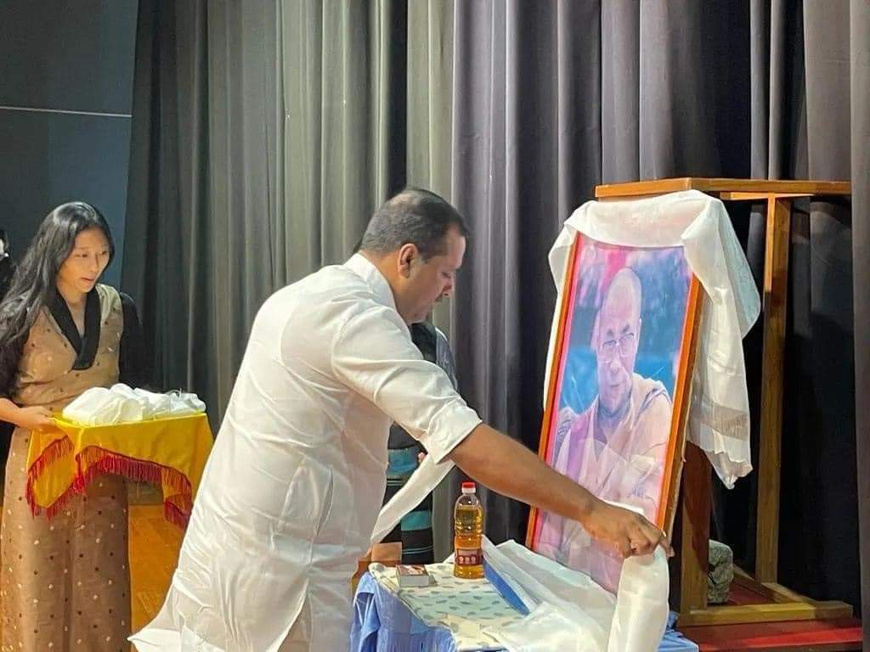
Support from local politician

Slide 23
How MTSU Functions
1
President
2
Executive members in all colleges.
3
Students

Slide 24
Presidents Till the dates

Slide 25
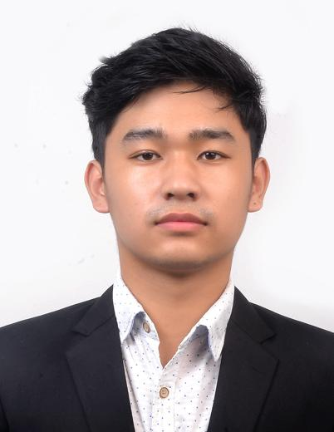
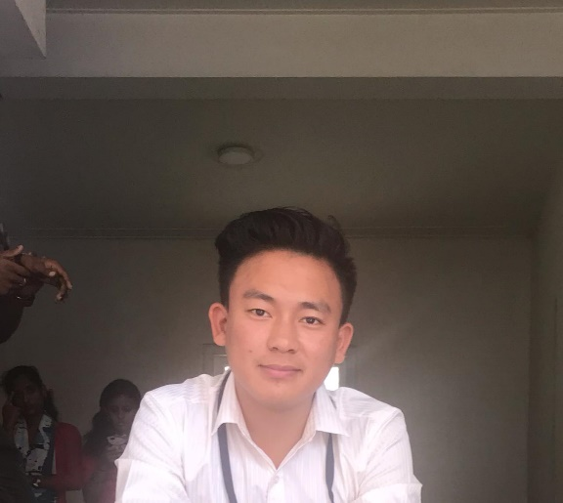
Tenzin Chokrap -2018-2019
Tashi Dolma - (2019- 2020)
Tashi Tenzin – (2020-2021)

Slide 26
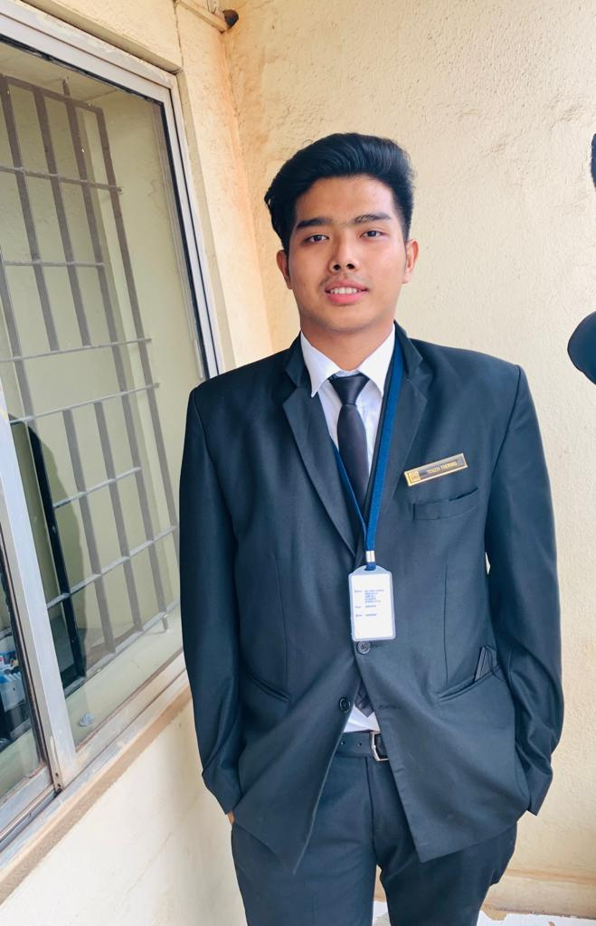
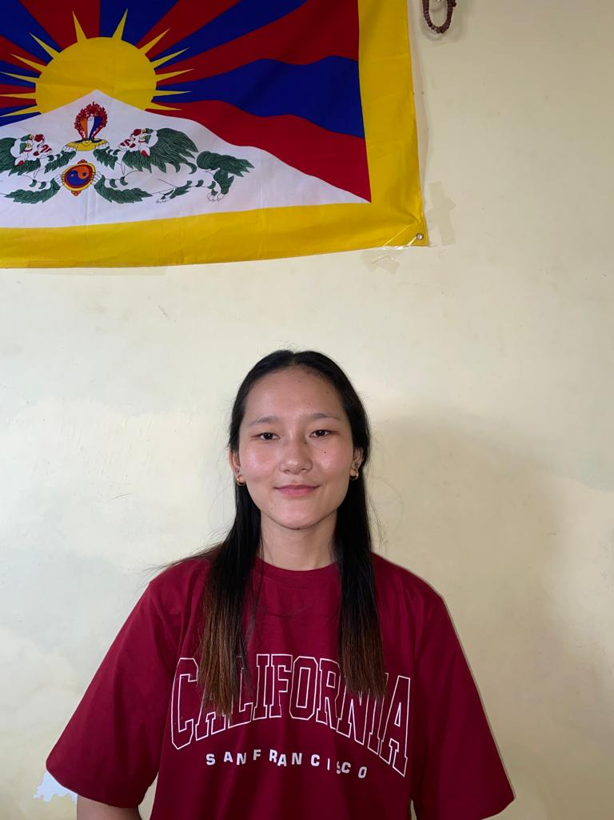
Tenzin Tsering 2021- 2022)
Tenzin Kyinzom ( 2022-2023)

Slide 27
THANK YOU

